Slide 1
Analyzing Redundant Memory Bounds Checks for Wasm2c
By: Allen Jue and David Lu

Slide 2

WebAssembly (wasm)
Wasm is increasingly popular in the wild
Wasm has security overheads¹
Wasm is a low-level language¹
[1] WebAssembly Security. WebAssembly. (n.d.). https://webassembly.org/docs/security/
Notes:
WebAssembly low level assembly like language complements JavaScript and is a compilation target for high-performance languages like Rust and C/C++. It enables developers to leverage the performance of native code while maintaining the security and portability guarantees on the web.

Slide 3



Wasm2c
Part of the Wasm Toolkit (wabt)
Decompiles Wasm into a C source and header
Why decompilation?
“Is This the Same Code?”²
Help understand the code
Existing tools to verify, analyze, and debug C code
wasm2c
[2] Wu et. al. (2024).
Notes:
Point 1: wasm2c’s ability to decompile Wasm into C code gives developers a familiar environment in which to inspect and modify WebAssembly modules. This helps bridge the gap between WebAssembly's binary format and traditional development workflows.
Point 3: By converting Wasm into C source, developers can take advantage of a wide range of tools designed for C, including performance analyzers, debuggers, and static analysis tools. This significantly increases the developer's ability to understand and optimize WebAssembly code.
Point 4: As the Wasm ecosystem matures, these decompilation tools are becoming increasingly crucial.

Slide 4
Wasm Overheads
Wasm has two goals³:
Security
Speed
For security, guard pages and bounds checking
Up to 650% overheads from memory bounds checks⁴
Cholesky Decomposition (20%)
GEMM (220%)
[3] Rossberg et al., 2018
[4] Szewczyk, 2022

Slide 5
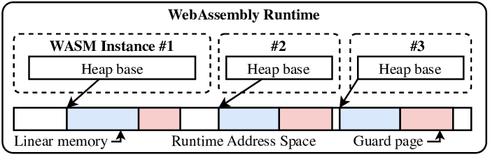
Wasm Memory Layout
A single large array of bytes
Can be grown in size as needed by the memory.grow instruction
4 primitive types supported:
32/64 bit floating point
32/64 bit integer
Image source: Fink et al., 2024
Notes:
Wasm memory is a large, linear array of bytes called linear memory. It supports 4 primitive types: 32/64 bit version of integers and floating points. It also can be grown dynamically through special instructions, such as memory.grow
Simplistic design - any other type has to be compiled down to instructions making use of these four primitive types before generating the final WebAssembly module.
Image source: (Fink et al, 2024)

Slide 6
Wasm Sandboxing
Sandboxing to help security
Typically done in 2 implementations:
Explicit bounds checks (validate every memory access beforehand)
Guard Pages (mark pages outside of instance as inaccessible)
Image source: Fink et al., 2024
Notes:
The WASM runtime must ensure that each instance can only access memory within the bounds of its accessible linear memory.
(i) explicit bounds checks to validate pointers within the WASM instance’s memory range
(ii) guard pages - map 4 GiB of virtual memory and mark any pages beyond as inaccessible
(https://arxiv.org/html/2408.11456v1)
Guard pages are out of scope for our project, but it’s worth noting that right now they are a field of active research (limited to 32-bit and special 64-bit systems)

Slide 7
Guard Pages
Used in wasm runtimes to detect out-of-bounds memory accesses
Are implemented as unmapped memory regions placed outside WebAssembly linear memory
Traps if a pointer out of bounds is accessed
In 64-bit Wasm, requires a specific configuration:
64-bit platforms
MMAP allocation strategy
No 64-bit memories
No big-endian architecture
Will fall back to bounds checks if not met
Notes:
Point 1 - Guard pages are fast and require minimum overhead on 32-bit systems, but in 64 bit their use is limited greatly.
32-bit pointers can only go up to 4GiB so page faults can be a good indicator of OOB.
recent memory64 feature proposal requiring 64bit addresses -> 32bit no longer works
64-bit WASM usually means switching to more expensive bounds checks.
(Trap = terminate)
Tangent: Recently there have been attempts to make 64-bit guard pages possible to help with the overhead incurred by SW bounds checks via 2-level guard pages (Döllerer & Engelke, 2024)
2-level guard pages: “With a maximum overhead of 17.3%, this approach proves to be a very beneficial strategy, also for larger and more complex applications.”
Source for conditions:
https://github.com/WebAssembly/wabt/blob/main/wasm2c/wasm-rt.h (line 140ish)

Slide 8
Guard Pages - Overhead
32 bit guard pages: Essentially 0 overhead
Two-level guard pages: 12.7% overhead
Single-level 64-bit guard pages: 76-142% overhead

Slide 9
Bounds Checks
Used in wasm runtimes to detect out-of-bounds memory accesses
Will cause a trap (termination) on OOB accesses
In 64-bit environments, are usually implemented instead of guard pages
Incur heavy overhead compared to guard pages
Notes:
More sophisticated reasoning:
In 32bit wasm all addressable WebAssembly memory is reserved in host virtual memory
Using page faults to identify OOB becomes less practical in 64bit
Guard pages have their own problems (only expand if asked)

Slide 10
Bounds Check Elimination
Dynamic type-level
Uses runtime knowledge of types and ranges to determine safe memory accesses dynamically.
Ex: Statistical check elimination and caching redundant checks
Static type-level
Compiler infers information about parameter types, sizes, and access patterns.
Reason about program without running it

Slide 11
Solution
We want to create a dynamic tool that tries to identify redundant bounds checks that will likely be identified by a static checker.
Criterion
Look at functions 1 frame away
Repeat bounds checks
Have pointer arguments passed in
Notes:
This keeps the analysis focused and computationally feasible by limiting scope to immediate function relationships.
Captures clear inefficiencies, as repeated checks on the same data are typically unnecessary if the bounds have not changed.
Focus on functions that explicitly receive pointers as arguments
Cons: these are very simple heuristics. We try to be conservatively correct, but there are redundant checks that are not eliminated

Slide 12
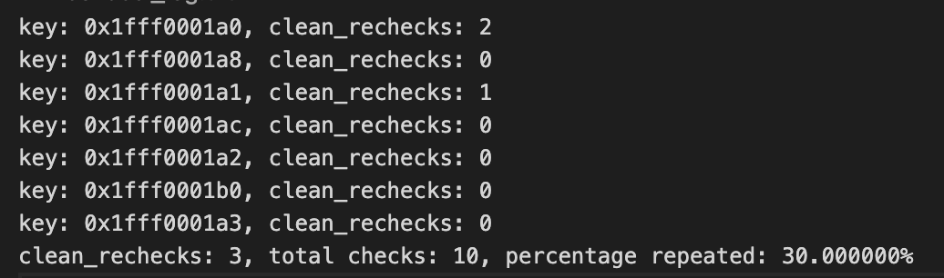
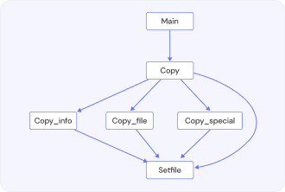
Solution
(1) wasm2c
(4) Run instrumented C code with Call Graph
GNU cflow
(2) Cflow Call Graph
(3) Python Call Graph Parsing
Notes:
We modified the wasm2c compiler to instrument memory accesses to check where a pointer was last validated during runtime, and we used this to detect redundant checks.

Slide 13
CFlow Example
int fibonacci(int n) {
if (n <=1) return n;
return fibonacci(n - 1) + fibonacci(n - 2);
}
int main (int argc, char **argv) {
return fibonacci(5);
}
main() <int main (int argc,char **argv) at fib.c:26>:
fibonacci() <int fibonacci (int n) at fib.c:10>:
fibonacci() <int fibonacci (int n) at fib.c:12>
fibonacci() <int fibonacci (int n) at fib.c:12>
Notes:
This is the static analysis part of the program, where we look at how methods call each other and pass in parameters. From this, we create a call graph that allows us to determine what methods call each other.

Slide 14
Implementation
MemoryInfo metadata object stored in a map that tracks bounds checks for all pointers
Track Caller-Callee relationships when pointers are validated
Identify repeated bounds checks
Track pointers that are passed in as parameters*
When a pointer is checked
Verified if a pointer meets all 3 criterion.
Otherwise, need to revalidate pointer
Notes:
We want to make sure that the memory we are checking is from the parameter. So at the start of every function we could use the function name, depth, and parameters as a composite key. Store the parameter in a location, and later, we double check the pointer value to see if it is the same. We understand this is not perfect, since it’s entirely possible to compute the value of the parameter with a series of computations. However, we’ve seen many examples in the code where variables passed through the parameter are immediately used in load and store instructions. This way, we check 3 things during runtime that we can probably infer with a static analysis.

Slide 15
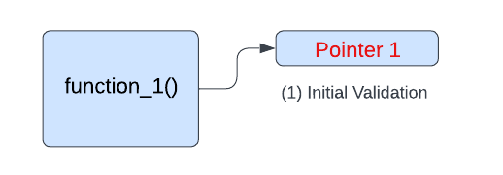
Implementation
Last checked depth: [1]

Slide 16
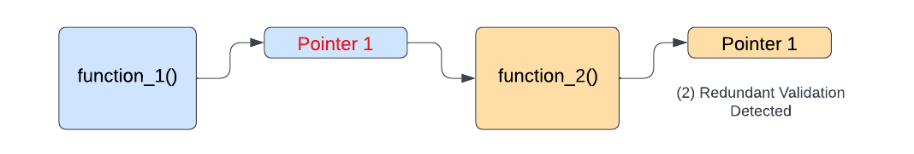
Last checked depth: [1]

Slide 17
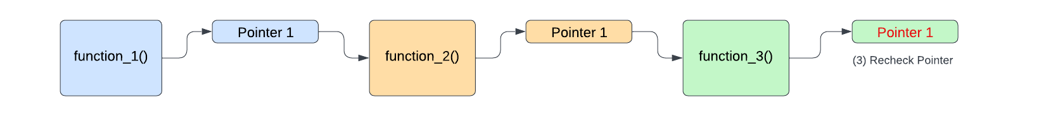
Last checked depth: [1, 3]

Slide 18
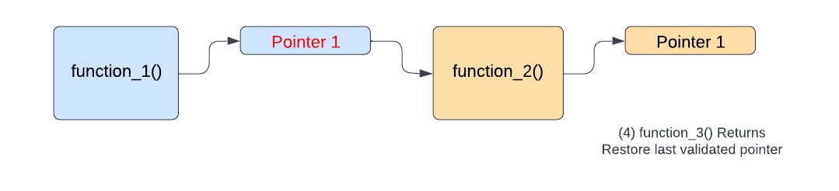
Last checked depth: [1]

Slide 19
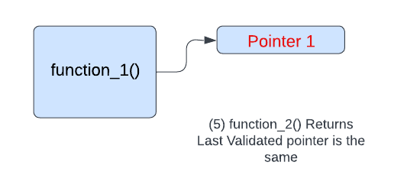
Last checked depth: [1]

Slide 20
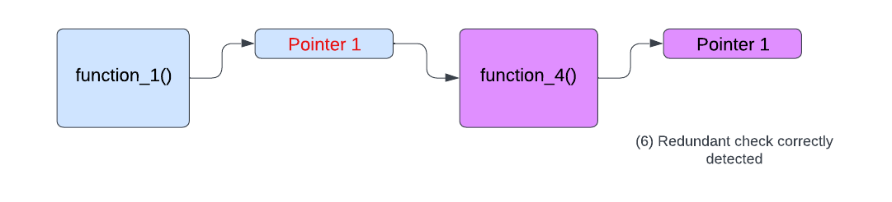
Last checked depth: [1]

Slide 21
Dhrystone Metrics
Dhrystone is a synthetic computing benchmark that tests programs meant to mimic common processor usages.
Criterion 1+2
Clean rechecks | 552,080,105
Total memory checks | 675,178,741
Percentage repeated | 81.77%
Overhead | 5,917%
Criterion 1+2+3
Clean rechecks | 21,770,370
Total memory checks | 332,778,455
Percentage repeated | 6.54%
Overhead | 9972%
Notes:
We are gaining insight into how Dhrystone has memory accesses, especially for statistically common programs. There is a significant amount of repeated pointer accesses with frame depths of 1! But we can’t easily capture all of these unless we take into account all 3 criterion. When considering the third criterion, which is pointer pointers passed by parameters, reverified in a function 1 frame away, then the total drops. However, I believe this can still be a significant boost in performance.
How much longer does this take?

Slide 22
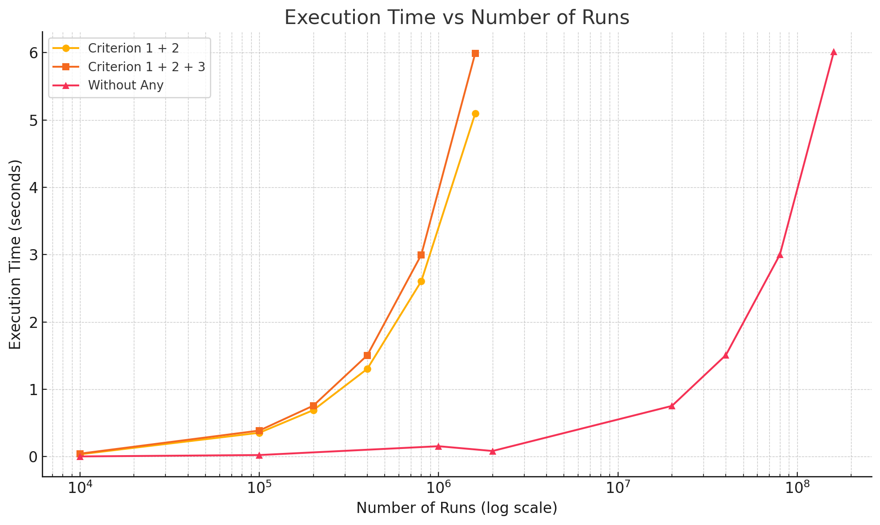
Notes:
There’s a linear growth for all of them. Notice the x-axis is logarithmic scale. So there is just a much larger constant for the linear time with the criterion put in place.

Slide 23
clean_rechecks: 552080105, total checks: 675178741, percentage repeated: 81.767993
10000 runs 0.034150 seconds
100000 runs 0.353827 seconds
200000 runs 0.689923 seconds
400000 runs 1.303460 seconds
800000 runs 2.604929 seconds
1600000 runs 5.098361 seconds
10000 runs 0.043790 seconds
100000 runs 0.386574 seconds
200000 runs 0.756544 seconds
400000 runs 1.505169 seconds
800000 runs 2.997267 seconds
1600000 runs 5.993094 seconds
Microseconds for one run through Dhrystone: 2.262293
Dhrystones per Second: 442029.428938
VAX MIPS rating = 251.581917
Microseconds for one run through Dhrystone: 0.037596
Dhrystones per Second: 26598295.747448
VAX MIPS rating = 15138.472252
Microseconds for one run through Dhrystone: 3.786496
Dhrystones per Second: 264096.392542
VAX MIPS rating = 150.310980
clean_rechecks: 21770370, total checks: 332778455, percentage repeated: 6.542001
10000 runs 0.002308 seconds
100000 runs 0.023105 seconds
1000000 runs 0.153953 seconds
2000000 runs 0.083223 seconds
20000000 runs 0.752998 seconds
40000000 runs 1.508573 seconds
80000000 runs 3.000045 seconds
160000000 runs 6.015423 seconds

Slide 24
Other metrics (fibonacci and matrix multiplication?)

Slide 25
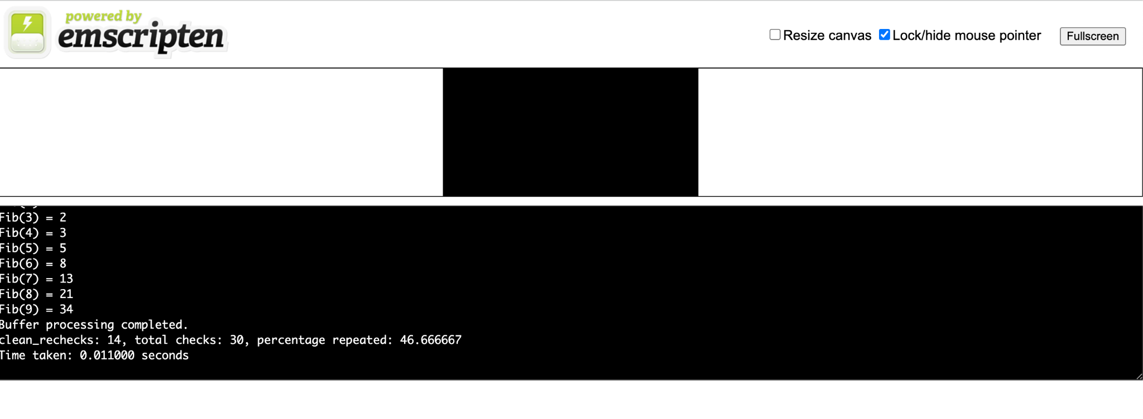
Emscripten (back to Wasm, how is it?)
Convert C module back to a Wasm module with minimal changes
Demonstrates flexibility of compiling back and forth

Slide 26
Further work
Returning pointers may be redundant
Create a basic static analyzer to see if performance benefits can be realized
Working on converting more complicated C modules back to wasm

Slide 27
Conclusion
For common programs, we can expect to eliminate an upper bound of 6.54% of bounds checks
Modules created from wasm2c can be converted back to wasm modules with Emscripten

Slide 28
References

